Slide 1



Weekly Meeting 4
Liri Chen, Shuo Liu, Wenqi Sun, Zhexin Wang, Zixiao Zhang

Slide 2
Milestone
Time | Milestone
Oct 18 - Oct 31 | OCR optimization
Nov 1 - Nov 21 | Prototype & demo(Search w/o GPT + WebApp)
Nov 22 - Nov 28 | Backend API & UI design
Nov 29 - Dec 16 | Final Presentation

Slide 3
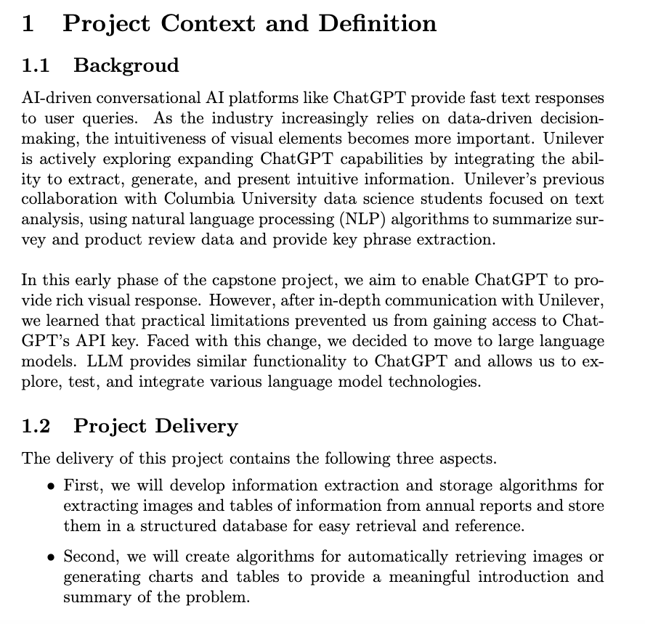
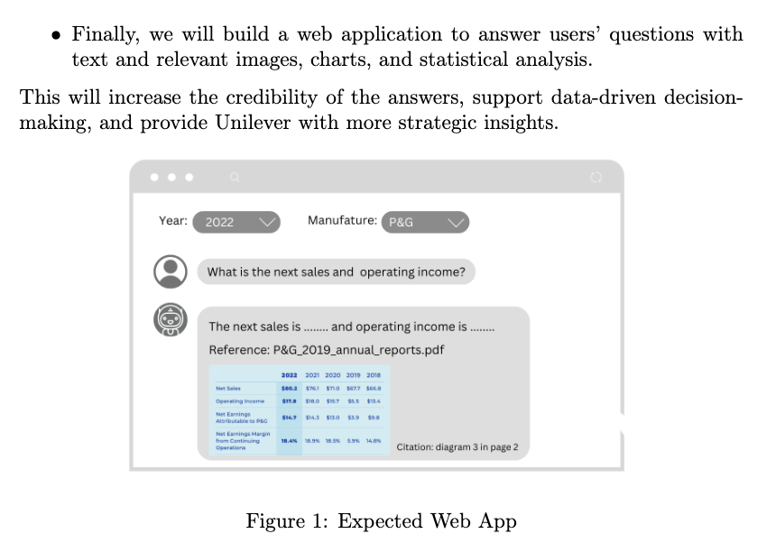
Changes in Project title and definition

Slide 4
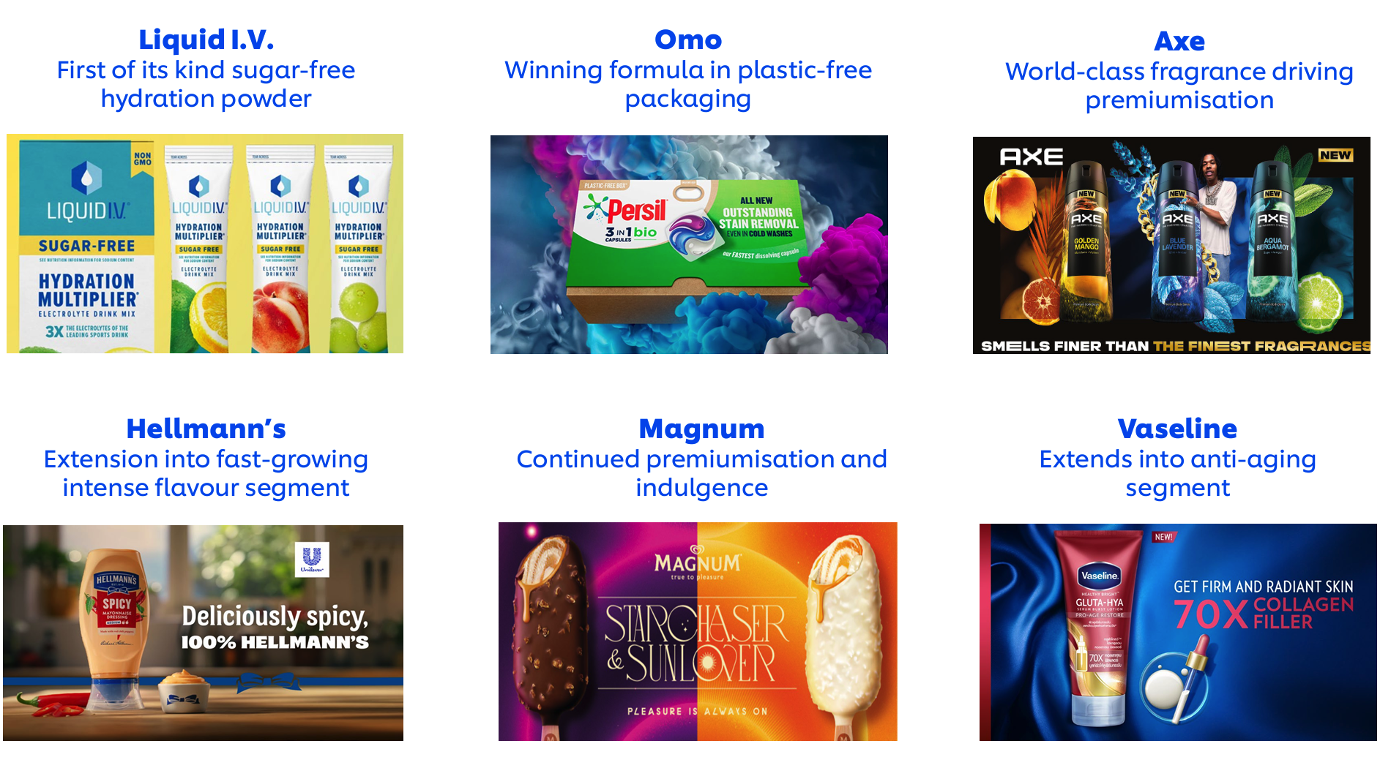
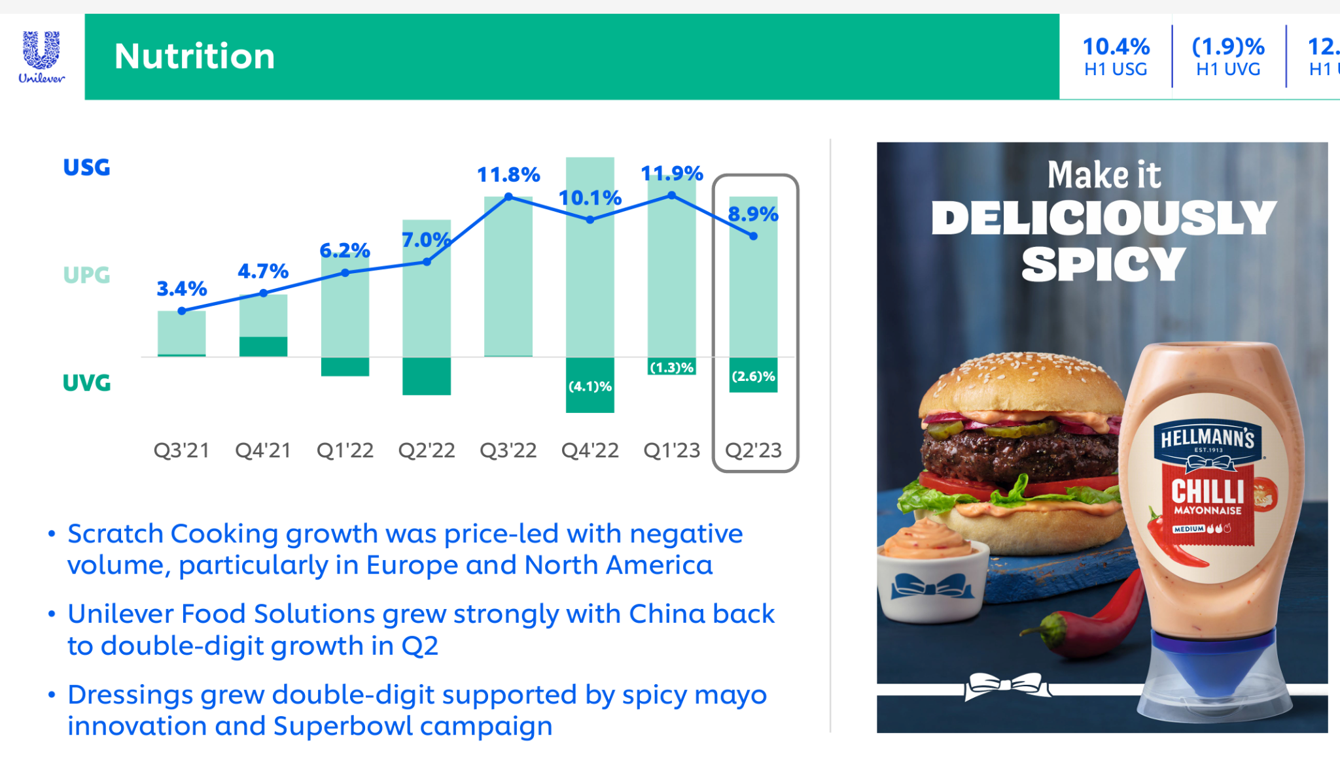
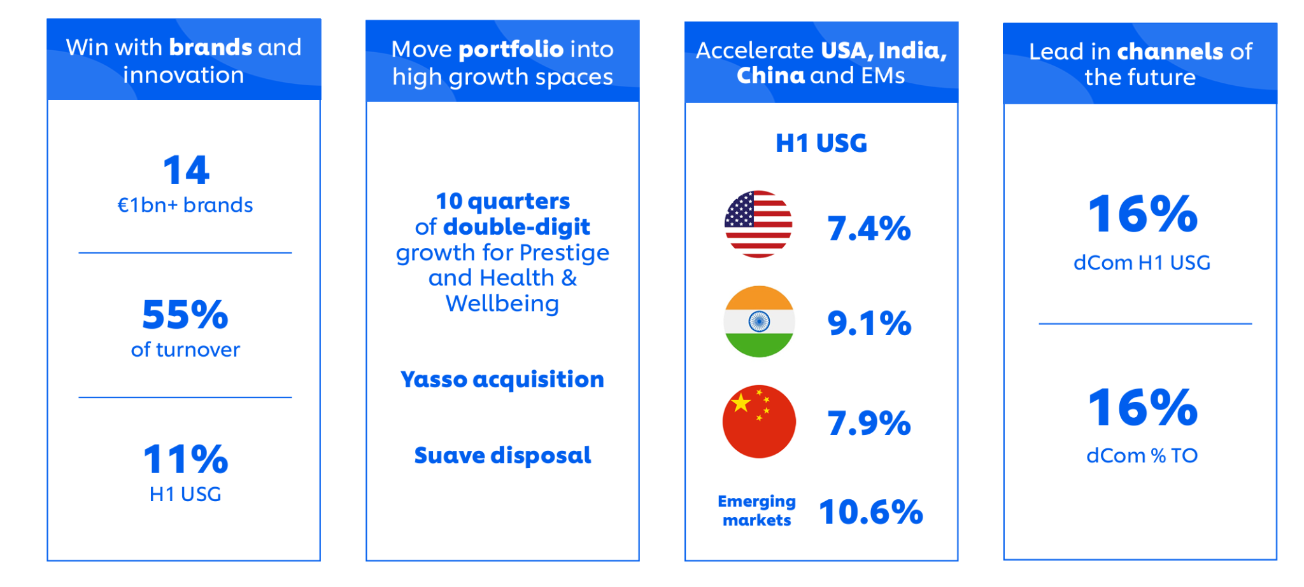
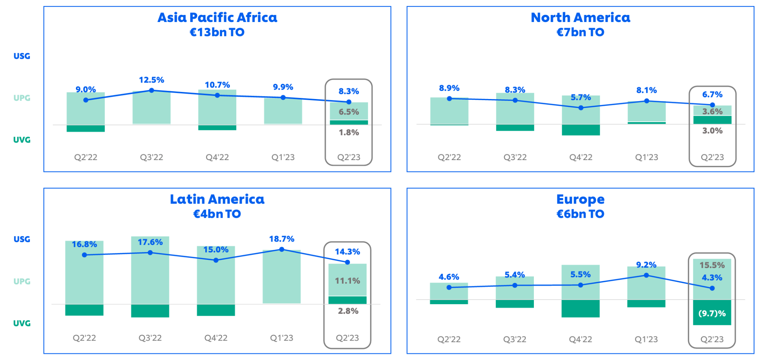
Unilever Annual Report Image Patterns

Slide 5
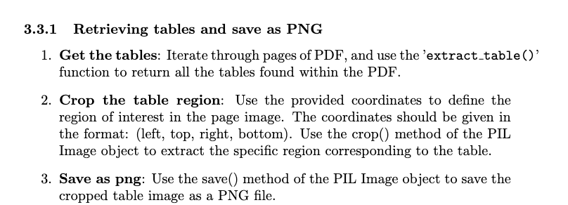
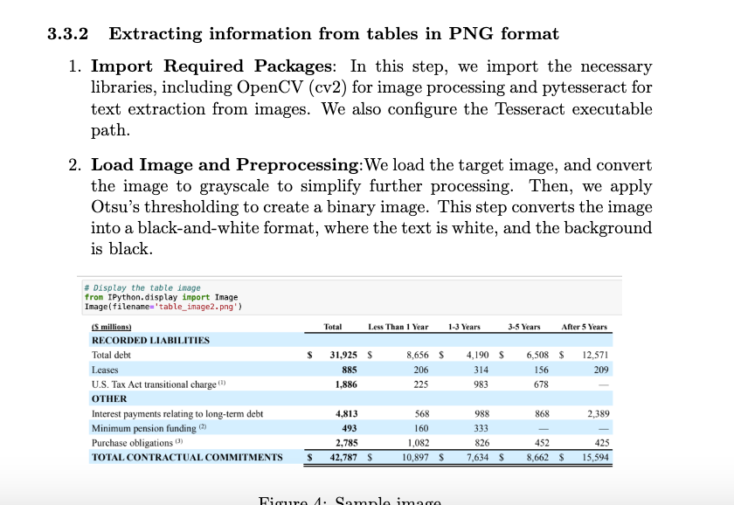
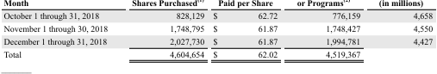
2-Step Table Retrieval
Problem:
Incomplete bounding boxes
Titles being cut off from the the table images

